Slide 1

ITDT5.228 INTRODUCTION TO DATA CONCEPTS

Slide 2
ASCII:
CHARACTER ENCODING SYSTEMS

Slide 3
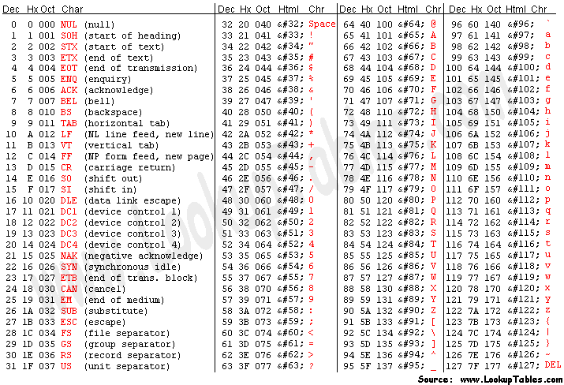
Character encoding
We know computers use binary to store information, but how does it translate into the text on your screen?
ASCII (American Standard Code for Information Interchange) is a character encoding standard that was designed for teletypes in 1960.
Standard ASCII can represent 128 characters. It uses 7 bits to represent each letter, number and punctuation character.
For example: A capital "T" is represented by 84, or 101 0100 in binary. A lowercase "t" is represented by 116 or 111 0100 in binary.
Instead of remembering the byte for each letter, symbol, and number, the ASCII founders organized them numerically & assigned them a decimal value.
ASCII (American Standard Code for Information Interchange)
Character Encoding Table
https://www.asciitable.com/

Slide 4

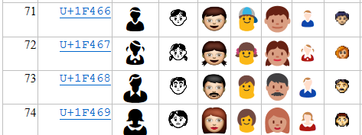
Character encoding
Video: “Understanding ASCII and Unicode (GCSE)”
Link: https://youtu.be/5aJKKgSEUnY?si=Re9_UqoQGd4_kgx4
ASCII
NotePad++ Open and View Binary File
Link: https://www.tutorialexample.com/notepad-open-and-view-binary-file-a-step-guide/
List of Unicode Symbols
Link: https://symbl.cc/en/unicode-table/
Emoji Unicode Tables
Link: https://apps.timwhitlock.info/emoji/tables/unicode

Slide 5
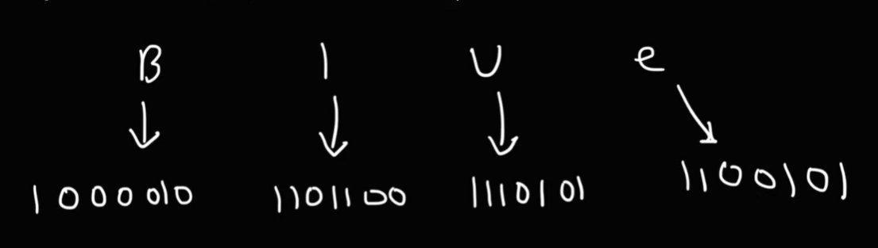
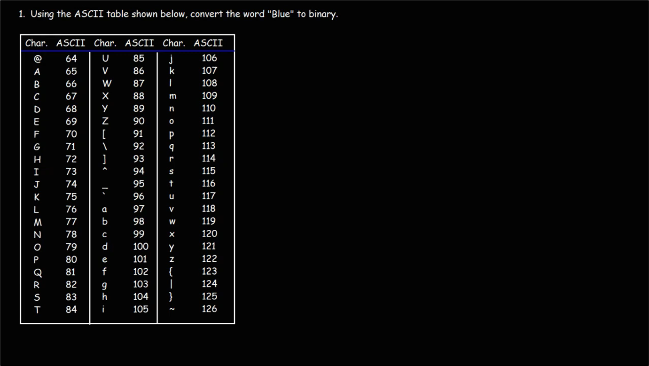

Decoder: convert “binary numbers” to “characters”
Video: “ASCII Code and Binary”
Link: https://youtu.be/H4l42nbYmrU?si=-4EAWfcKLqjzK3Il
Using the ASCII table to convert the following “binary coded message” into a word (characters):
“1001100 1100101 1101101 1101111 1101110”

Slide 6
Hash Table

Slide 7
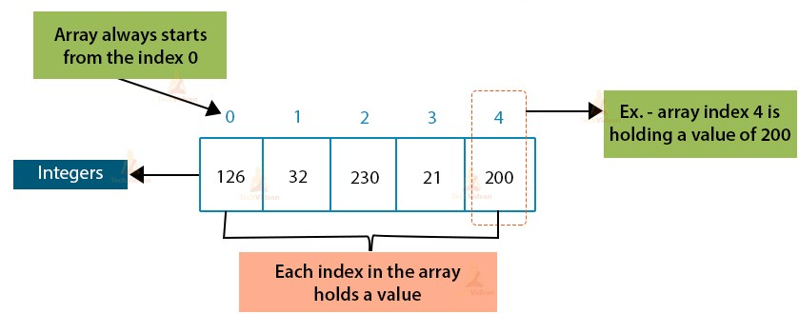
ARRAY
P | I | N | K | J | A | C | K | E | T
Array is a container which can hold a fixed number of items and these items should be of the same type:
Fixed size
Random Access: Use index to access to data element
array
Index | Data
0 | Ian
1
2
3
4
5
6
7
8
9 | Daniel
Hash function: Mod
Data
HASH TABLE
Daniel
Ian
Oliver
Emre
Noor
In Hash Table, data is stored in an array where each data value has its own unique index value ➔ Access of data becomes very fast because we know the index of the desired data.
Hash function or Hash algorithm is technique used to generate an index where an element is to be inserted.
Notes:
Hash Table is a data structure which stores data in an associative manner. In a hash table, data is stored in an array format, where each data value has its own unique index value.
Hash Table uses an array as a storage medium.
Use hash technique to generate an index where an element is to be inserted or is to be located from.
Hash table data structure allow the data insertion and search operations very fast irrespective of the size of the data.
Access of data becomes very fast because we know the index of the desired data.

Slide 8
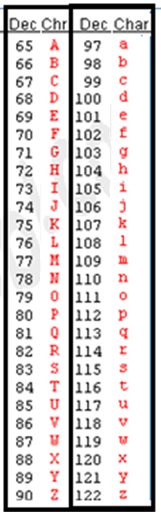
Step 1: Calculate Data Hash Key
Hash Key = Sum of ASCII values of all characters in the “name” (data) by using ASCII table
Calculate “data key”
By using ASCII code
Data
Data Hash Key
Daniel
Ian
Oliver
Emre
Noor
68 + 97 + 110 + 105 + 101 + 108 = 589
73 + 97 + 110 = 280
79 + 108 + 105 + 118 + 101 + 114 = 625
69 + 109 + 114 + 101 = 393
78 + 111 + 111 + 114 = 414
Notes:
1) The Data (content value is converted into a unique integer key or hash by using a hash function. It is used as an index to store the original element, which falls into the hash table.
In the above diagram, value 1 in the hash table is the unique key to store element 1 from the data array given on the LHS of the diagram.
#2) The element from the data array is stored in the hash table where it can be quickly retrieved using the hashed key. In the above diagram, we saw that we have stored all the elements in the hash table after computing their respective locations using a hash function. We can use the following expressions to retrieve hash values and index.
hash = hash_func(key) index = hash % array_size

Slide 9
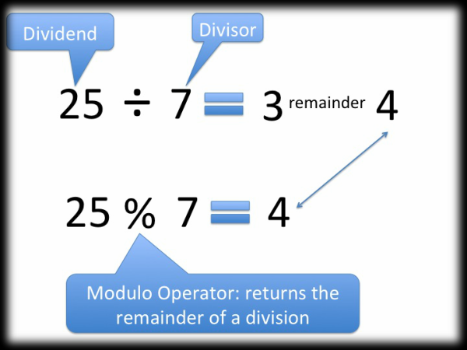
Step 2: Calculate index
Hash function is used to convert a “data hash key” into a range of indexes of an array by using the MODULO operator.
Index = “Data Key” mod 10 (because array size = 10)
Array: 10 elements
Modulo operator
(Modulo 10: % 10)
Index | Data
0 | Ian
1
2
3 | Emre
4 | Noor
5 | Oliver
6
7
8
9 | Daniel
280 % 10 = 0
Data
Hash Key
Daniel | 68 + 97 + 110 + 105 + 101 + 108 = 589
Ian | 73 + 97 + 110 = 280
Oliver | 79 + 108 + 105 + 118 + 101 + 114 = 625
Emre | 69 + 109 + 114 + 101 = 393
Noor | 78 + 111 + 111 + 114 = 414
393 % 10 = 3
Search process:
In order to find “Noor” in the array:
+ Convert “Noor” into data key.
+ Modulo this data key by 10.
414 % 10 = 4
625 % 10 = 5
589 % 10 = 9

Slide 10
Step 3: COLLISION
Assume there are now 7 data items as shown below. Two additional data items — “John” and “Aman” — are to be inserted. Calculate the hash key for each new data item, determine the corresponding index in the hash table using the hash function, and then insert the items into the array accordingly.
Modulo operator
(Modulo 10: % 10)
Array: 10 elements
Index | Data
0 | Ian
1 | Aman
2
3 | Emre
4 | Noor
5 | Oliver
6
7
8
9 | Daniel, John
Calculate “data key”
By using ASCII code
Data
Hash Key
Data
Daniel
Ian
John
Oliver
Emre
Noor
Aman
68 + 97 + 110 + 105 + 101 + 108 = 589 | Daniel
73 + 97 + 110 = 280 | Ian
74 + 111 + 104 + 110 = 399 | John
79 + 108 + 105 + 118 + 101 + 114 = 625 | Oliver
69 + 109 + 114 + 101 = 393 | Emre
78 + 111 + 111 + 114 = 414 | Noor
65 + 109 + 97 + 110 = 381 | Aman
“A collision occurs in a hash table when two different data items produce the same hash index. Since both items try to occupy the same position in the array, the hash table must use a collision‑handling strategy to decide where to store the second item.”
Problem: Collision or Duplicate

Slide 11
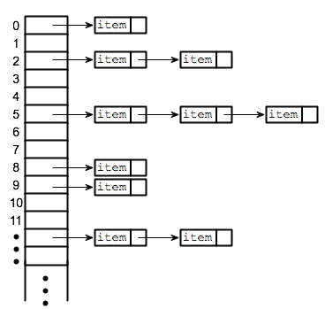
Step 4: COLLISION HANDLING
This is the major problem. Fewer collisions the better.
Accept collisions and work with them.
Solution 1: Look into the hash table and tries to find another open slot to hold the item that caused the collision.
Solution 2:
Use Linked List to store all data in the same slot.
Index | Data
0 | Ian
1 | John
2
3 | Emre
4 | Noor
5 | Oliver
6
7
8
9 | Daniel
Index | Data
0 | Ian
1
2
3 | Emre
4 | Noor
5 | Oliver
6
7
8
9 | Daniel
Reading more: https://tutorialspoint.dev/data-structure/hashing-data-structure/hashing-set-2-separate-chaining
Linear Probing
/ Open addressing
Reading more: https://en.wikipedia.org/wiki/Linear_probing
Separate chaining
John

Slide 12
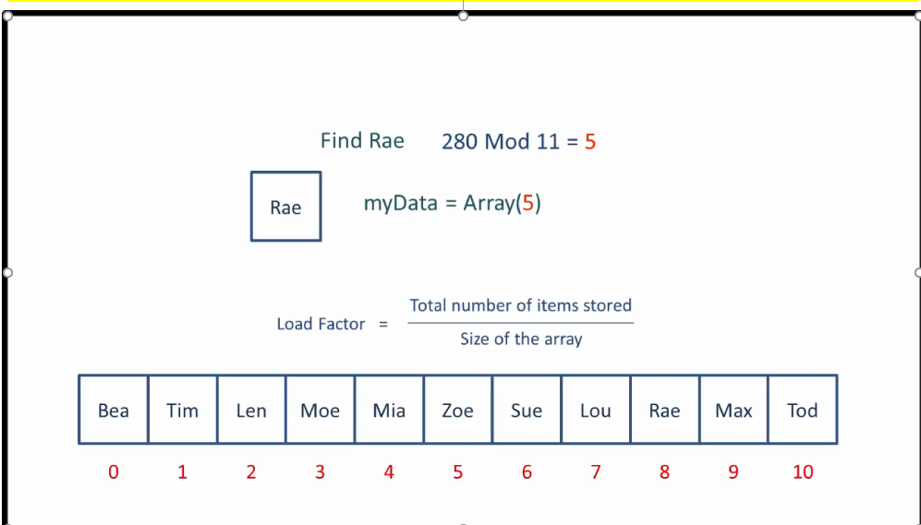
Hash Table: A data structure that stores key-value pairs, where the key is used to determine the location (index) of the value within the table. In hash tables, collisions occur when different keys map to the same index. To resolve this, common techniques include separate chaining (using linked lists to store multiple values at the same index) and open addressing (finding an alternative empty slot).
VIDEO CLIP: “Hash Tables and Hash Functions”
https://www.youtube.com/watch?v=KyUTuwz_b7Q&t=2s

Slide 13
Exercise:There are 10 data items provided below, along with an array capable of storing up to 15 elements. Using an appropriate hashing technique, compute the hash key for each data item, determine the corresponding index position within the array, and then insert each item into the array according to the hashing results. Use “Linked List” (separate chaining) to store all data in the same slot to handle the “collision” problem
Array: 15 elements
Index | Data
0
1
2
3
4
5
6
7
8
9
10
11
12
13
14
Modulo ???
Data
Erin
Barry
Harry
Fred
Andrew
Ian
David
Grant
Colin
Daniel
key
Notes:
10 data = (Erin, Barry, Harry, Fred, Andrew, Ian, David, Grant, Colin, Daniel)

Slide 14

VIEW AT HOME
Video: “Characters, Symbols and the Unicode Miracle - Computerphile”
Link: https://youtu.be/MijmeoH9LT4?si=RZP88AxRNopQK3Uk

